Slide 1
Soft computing Part 1
Arnaldo Sepulveda

Slide 2
Introduction
Soft computing deals with imprecision, uncertainty, partial truth, and approximation to achieve tractability, robustness and low cost solution
Components of soft computing:
Artificial Neural networks (ANN)
Fuzzy Systems (FS)
Evolutionary Algorithm (EA) or Genetic Algorithms (GA)
Swarm intelligence = PSO

Slide 3
Introduction
The role model for soft computing is the human mind
Combination of soft computing techniques:
Fuzzy-GA (FS and GA)
Neuro-GA (ANN and GA)
Neuro-Fuzzy (ANN and FS)
Neuro-Fuzzy-GA (ANN, FS and GA)
Neuro-PSO (ANN and PSO)
Neuro-Fuzzy-PSO (ANN, FS and PSO)

Slide 4
Artificial Neural Networks (ANN)
Mathematical model that tries to simulate the structure and function of biological neural networks
ANN is an adaptive system that changes its structure based on external or internal information that flows through the network during the learning phase.

Slide 5
Structure ANN
http://en.wikipedia.org/wiki/Artificial_neural_network

Slide 6
Fuzzy Logic (FL)
Used to represent human knowledge (linguistic information) and use that knowledge to make useful inferences to control processes
IF brake temperature IS warm AND speed IS not very fast THEN brake pressure IS slightly decreased [wiki]
Deal with uncertainty and imprecision
Ability to accomplish a task without knowing the mathematical model of the system (nonlinear, time varying and complex).

Slide 7
Fuzzy Logic
Used in control applications where concepts cannot be expressed as “true” or “false”, but somewhere in between due to imprecision.
Imprecision of tools, influence of observer,...
Imprecise statements: temperature is about 4
Range for the inputs are called the universe
Structure of FL:
Fuzzification, Inference, Defuzzification, Knowledge Base

Slide 8
Fuzzy Logic Controller (FLC)

Slide 9
Fuzzification
Transform the input into a normalized fuzzy subset
X1 = 2.5 ; X2 = -0.2;
Y axis: membership function, value between 0 and 1
X axis: universe of input X or range of X
Look up fuzzy sets that were “hit” in the input window
X1 = PS and PM; X2 = NS and Z;
Look up sets on the fuzzy rules
Control signal: u = 3.83

Slide 10
Set fuzzy input window for X1

Slide 11
Set fuzzy input window for X2

Slide 12
Knowledge Base or Rule Base

Slide 13
Control Signal

Slide 14
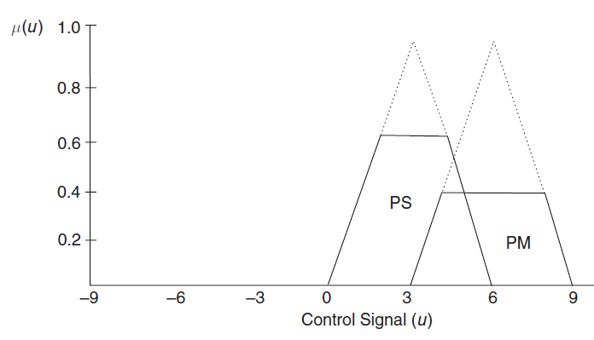
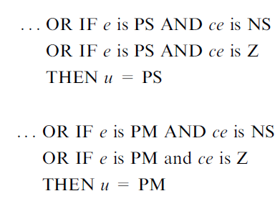
Fuzzy Inference

Slide 15
Defuzzification

Slide 16
Issues Fuzzy System
Learning:
Difficulties with the process of self-learning
Knowledge obtained from previous experience: physical laws, data, system expert
Optimization
FL has no way of optimize rules by itself
Need process or method to find knowledge about system.

Slide 17
Genetic Algorithms
Genetic algorithms are search methods that employ processes found in natural biological evolution
Algorithms search on a given population for a solution that approach some criteria
Algorithm applies the principle of survival of the fittest individuals to find better approximations
Include the three fundamental genetic operations of selection, crossover and mutation

Slide 18
Steps GAs

Slide 19
Roulette wheel Selection

Slide 20
Evaluate fitness function

Slide 21
Genetic material transfer

Slide 22
Random alteration genetic material

Slide 23
GA Issues
Find fitness function (not needed on FS)
Local minima and premature convergence
Mutation interference

Slide 24
Example:
Find maximum of a function f of one variable x
f(x) = 20+100*x*cos(4*pi*x)*e^(-2*x)
Range optimization: [0,1.5]
Chromosomes: X1, X2, X3, ..., X10
Binary encoding: 001010101011
Decimal value: 0.505
Fitness: 38.393

Slide 25
Original: fitness=201

Slide 26
fitness=269

Slide 27
fitness=270

Slide 28
After 16 iterations, fitness=361

